Slide 1
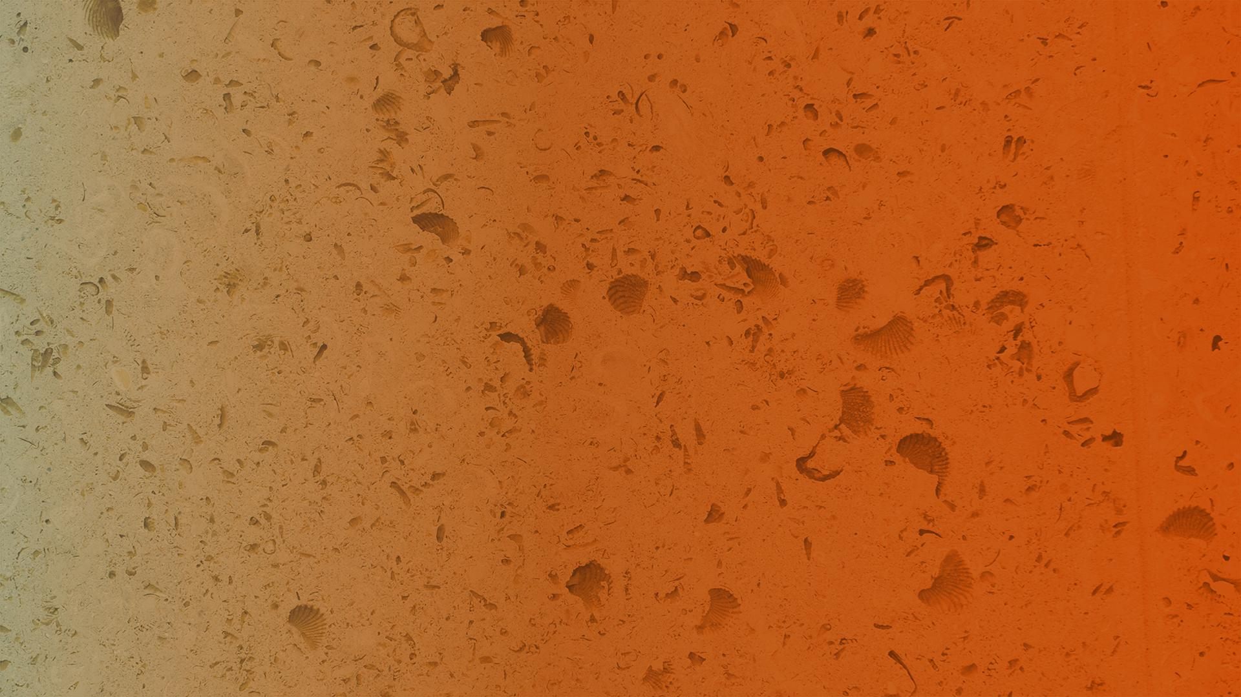

FEBRUARY 12, 2019
CRITIQUE: STREAMING WEAK SUBMODULARITY: INTERPRETING NEURAL NETWORKS ON THE FLY
Elenberg, E., Dimakis, A. G., Feldman, M., & Karbasi, A., NIPS 2017
Critique presented by
Marius Arvinte, Mai Lee Chang
The University of Texas at Austin

Slide 2
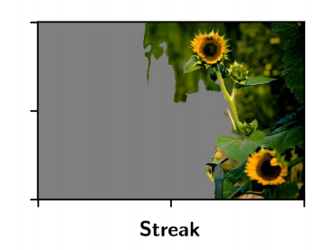
Interpretability vs. Explainability
Does the paper interpret or explain?
Seems more like explain.
Notes:
Did not perform interpretability evaluation

Slide 3
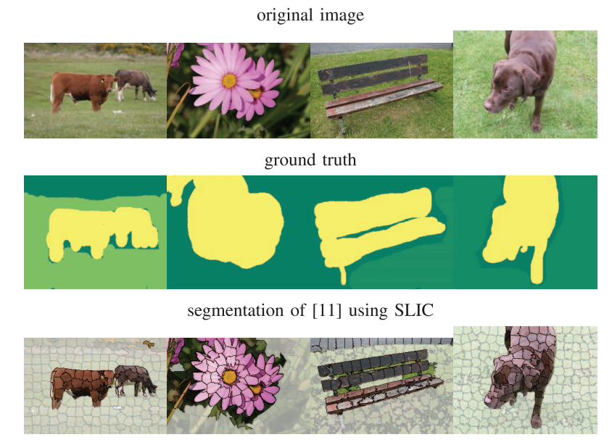
Some interpretability issues
SLIC [Achanta ‘12] algorithm used for image segmentation.
Already uses “ground truth” = objects in the algorithm.
How much of the interpretability comes from SLIC vs. Streak?
What happens when segmentation is not object-specific i.e. uniform 2D grid?
SLIC itself is relatively processor-heavy
~15s for 2048x1536 image

Slide 4
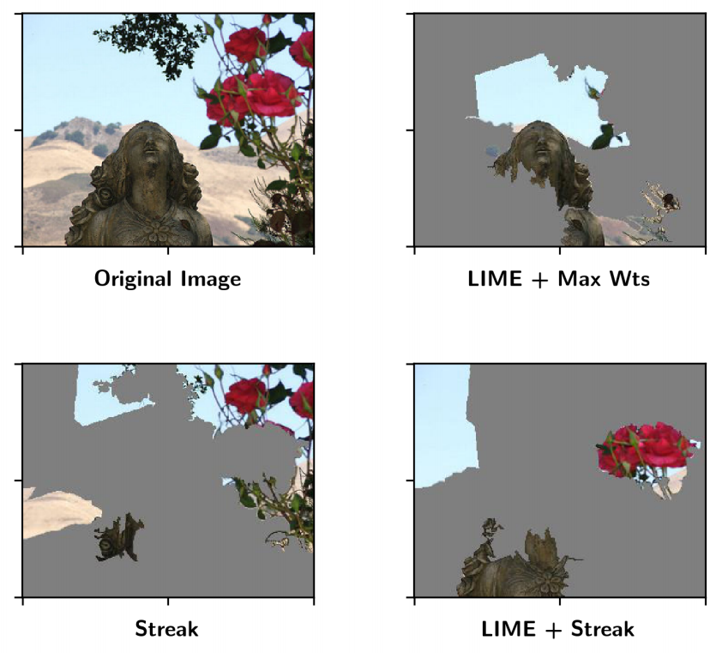
Some interpretability issues
Segmentation becomes especially important when dealing with small/sparse objects in pictures.
E.g. From the extended version of the Streak paper:
What happens if a grid segmentation cuts the roses in halves?
Do we lose weak submodularity / break Streak?

Slide 5
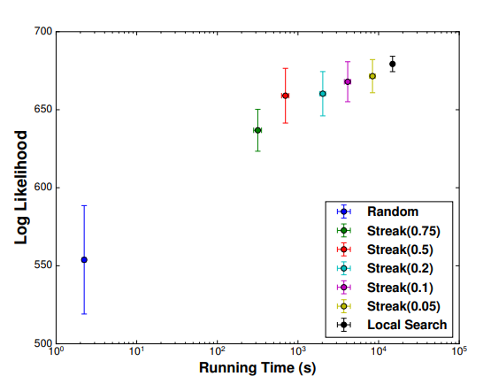
Choice of ε
The algorithm is parametrized by ε, controlling the complexity / performance trade-off.
Time complexity scales with 1/ε
Performance guarantee scales with (1 - ε)
The paper offers no guidance on how to pick ε.
This makes it impossible to preserve the streaming setup.
Furthermore, it’s likely that ε depends on the specific image / application → No universal value exists.

Slide 6
Extending to other datasets
The experiments work mainly because weak submodularity is assumed for images.
I.e. For most images, a number of k patches is good enough for classification.
Interesting to extend submodularity to other types of data:
Does it hold for?
Text (with letters/words as patches) → Likely
Audio (with phonemes as patches) → Likely
Financial → Probably not
Medical → Probably not

